Slide 1
OTP Transit Index and TriMet
Data and functional gaps in the
Transit Index regarding TriMet data
November 2016

Slide 2
issue #1: current stops
Things to look at:
On ride.trimet.org stops are only shown that are currently active
Look at the circles between this page and the next, and notice how many more stops show up on call.trimet.org

Slide 3
issue #1: current stops
Things to look at:
The call.trimet.org system has a stop overlay like ride.trimet.org
Problem is there's no filtering of stops that appear in TriMet's GTFS.zip file.
Often stops in the GTFS are not active at certain points in the schedule.
Determining an effective schedule period requires looking at all the trips in the GTFS, and determining which stops have service … for this reason, we choose to go the gtfsdb route for our pages

Slide 4
issue #1: current stops
Things to look at:
The stop in call.trimet.org looks like a normal stop, and shows information like it was an active open stop.
Only by planning a trip from the stop do we get some hint that the stop is not active.

Slide 5
issue #2: stops types
Things to look at:
On ride.trimet.org, we have 5 different icons for stops.
Here you see blue bus icons, small black streetcar stops and larger black MAX icons

Slide 6
issue #2: stops types
Things to look at:
Within the OTP transit index, there is no concept of stop (mode) type.
Thus in call.trimet.org, there's no differentiation between the different rail and bus modes servicing stops.

Slide 7
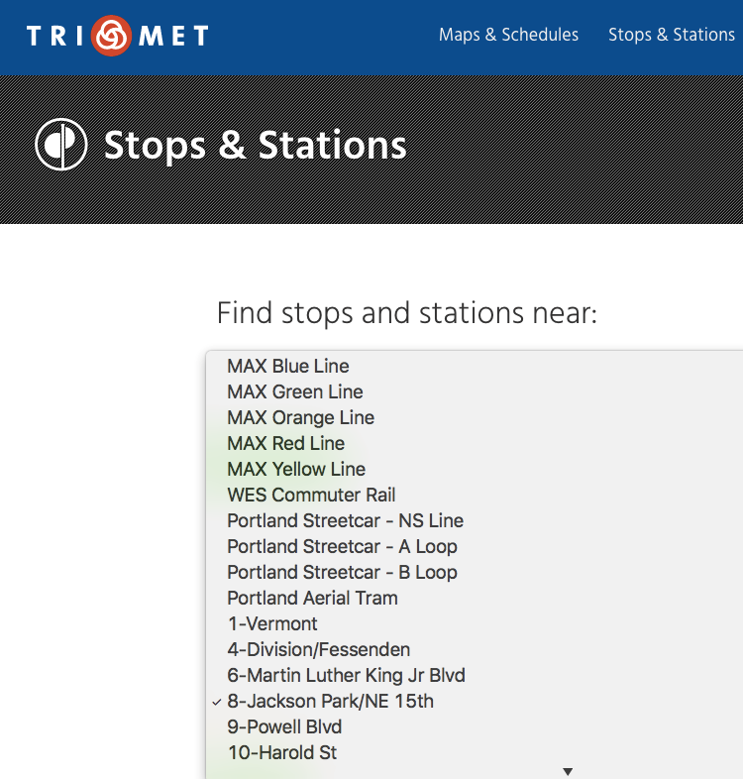
issue #3: route sort order
Things to look at:
There's a proposed extension in GTFS, where a route sort order column is added to routes.txt
TriMet supplies the route sort order, and gtfsdb reads and returns this info

Slide 8
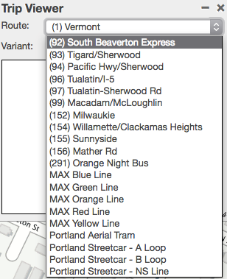
issue #3: route sort order
Things to look at:
The OTP transit index (and OBA gtfs libs) are not reading route sort order

Slide 9
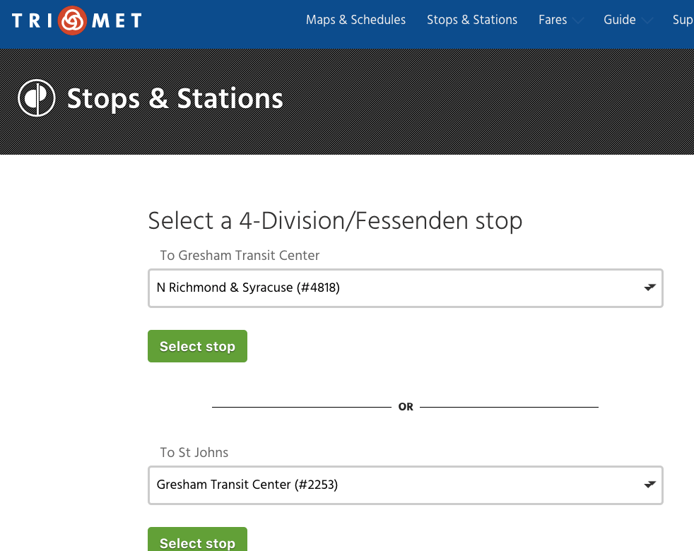
issue #4: route direction
Things to look at:
There's a proposed extension in GTFS's to add route_directions.txt
TriMet supplies route_directions.txt, and gtfsdb reads and returns this info

Slide 10
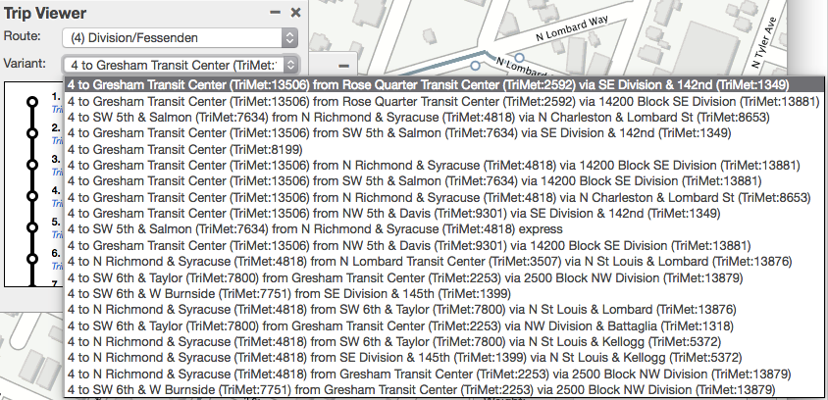
issue #4: route direction
Things to look at:
Without route_directions.txt, one alternative is to show all route patterns as variations the route may take.
Listing route patterns doesn't lend itself to a useful route pull down UI.
Use of the he GTFS extension route_directions.txt would help here.

Slide 11
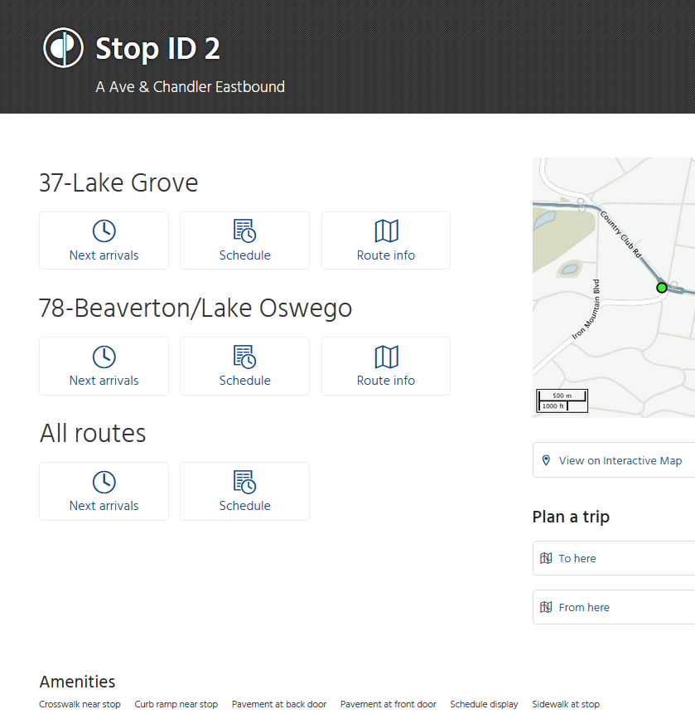
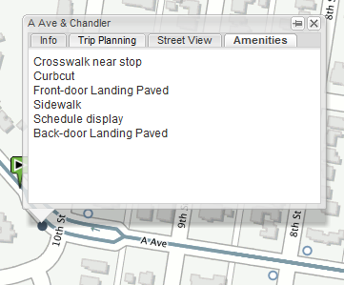
issue #5: stop amenities
Things to look at:
The current map and stop pages show stop amenities.
Yet another proposed extension to GTFS, of which GTFSDB has an implementation.

Slide 12
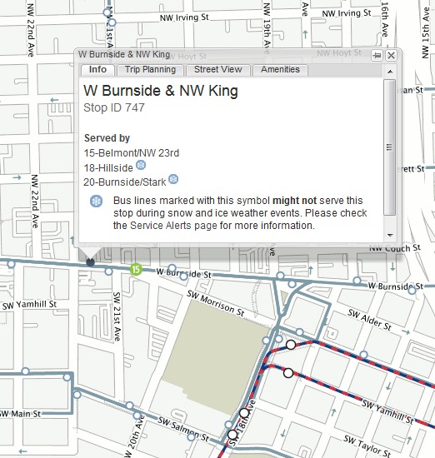
issue #5b: route stop / snow
Things to look at:
Another 'amenity' for a stop is the ability to mark the stop as a 'snow' stop for a given route.
How we would even represent this via GTFS is an unknown at this point.
But it is something we've done in the past with data from TRANS (not gtfs).

Slide 13
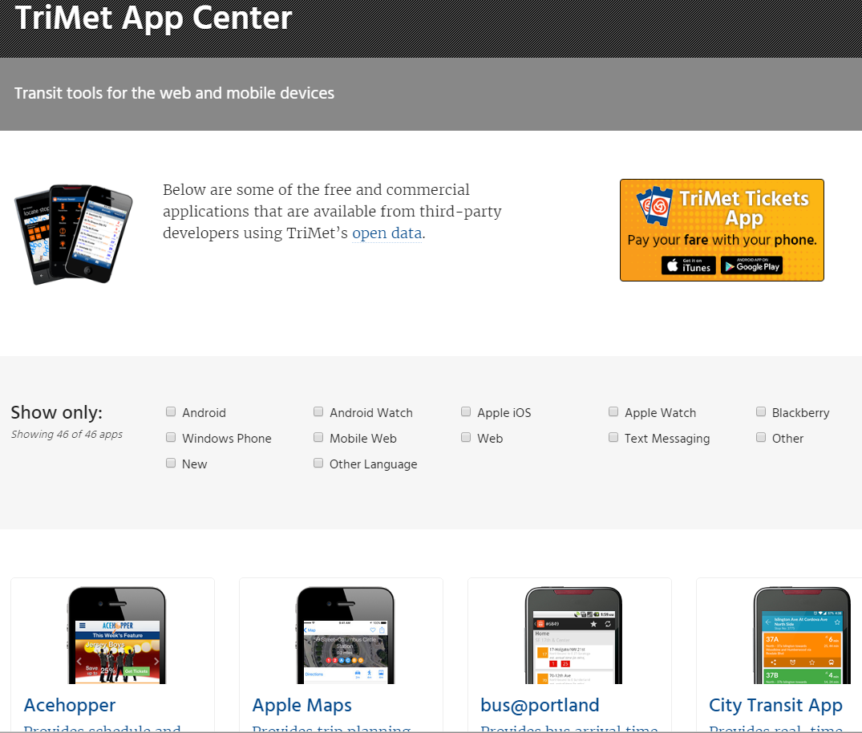
Issue #6: developer.trimet.org
Things to look at:
We expose a developer API to 3rd parties
We have to be careful with changes to this API, since we have customers using apps that could break with any API change
There's also concern that some apps no longer have an active developer who can adapt to any API changes.
We currently have an API Wrapper atop OTP, which insulates the 3rd party apps from change

Slide 14
Pros & Cons to using GTFSdb
(rather than OTP transit index)
PROS
GTFSdb is successfully running at TriMet now
If OTP React is built to be back-end agnostic == more flexible & adaptable system
No need to fix the OTP index to work with TM data
OTP should focus on being the best routing engine it can be..original architecture
Wrapper insulates 3rd party developers from OTP change
CONS
Requires development here at TriMet (OSS)
Adds complexity to OTP React front-end code
Might want to fix OTP regardless of this project
It takes more effort to host, maintain and populate more than one system
Wrapper WS is not (yet) widely adopted by transit app developers

